Slide 1



GLOBAL AI HACKATHON
Emotional Hero – the iOS app
Team: WhatTheHack?!
Ben, Chris, Julia, Shiv & Tony
Munich 26th June, 2017
#GlobalAIHack #WhatTheHack

Slide 2
WHY?
Do you feel uncomfortable about the way your face looks when you express an emotion?

Slide 3
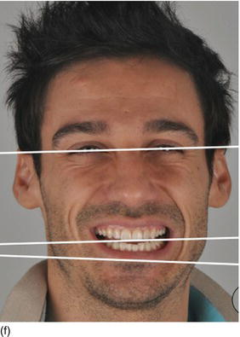
WHY?
Do you think you have got an asymmetrical smile or laughter?

Slide 4

WHY?
Do you want to train your facial muscles for a slimmer and more defined look but don’t know how?

Slide 5

WHY?
Do you want to improve your selfies / photos by training on your facial expressions?

Slide 6
WHY?
Most importantly: Have fun!

Slide 7
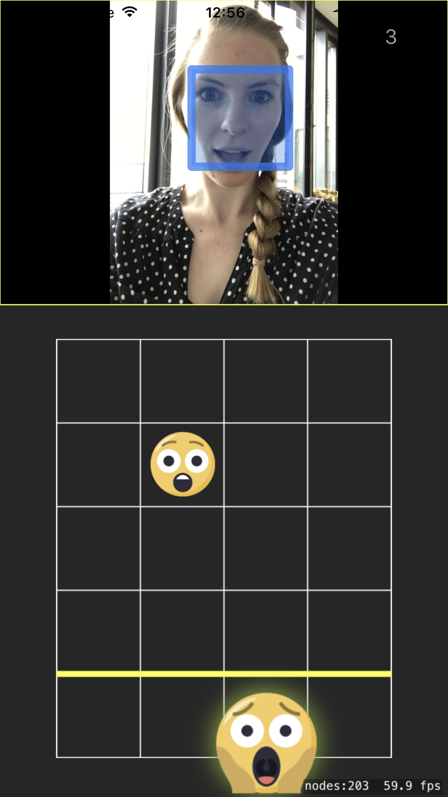






WHAT?
GuitarHero inspired iOS game
Smileys flow down the screen -mimic them
Score points on our Leaderboard

Slide 8
DEMO

Slide 9
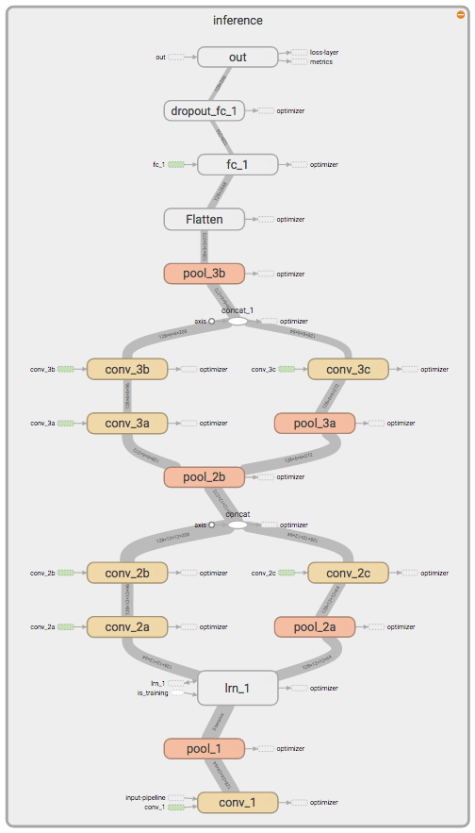



HOW? – Step 1. Training on GPU
TRAINED
MODEL
Emotion Detection Network (Tensorflow & Keras)
Inspiration from: Peter Burkert and (2015). DeXpression: Deep Convolutional Neural Network for Expression Recognition. CoRR, abs/1509.05371, .

Slide 10

HOW? – Step 2. iOS Application
Face Detection using Core Image (iOS)
{0.05, 0.05, 0.7, 0.09, 0.01, 0.2}
Model Predictions
✔️
WELL DONE!
Loaded with trained TF Model using CoreML (iOS)

Slide 11
Upcoming Surprises
1) Integration of iOS app to the Leaderboard
> already setup server with REST API
2) Publish on iOS store
3) Android/Windows phone codebase

Slide 12
THANK YOU

